Slide 1
Extended ETL Framework on Cloud Resources and its engine “awsub”
Hiromu OCHIAI, Kenichi Chiba, Ai Okada and Yuichi Shiraishi
National Cancer Center Japan

Slide 2
Background
With the advancement of Cloud Services (which mean IaaS, PaaS, SaaS and so) researchers of biology and bioinformatics started to use cloud resources for genome analysis instead of using on-premise server resources.
Because most bioinformaticians are used to use huge clustered machines, building cluster is one of the way to execute genome analysis on cloud.
Here we suggest using ETL by which cloud resources can be procured more efficiently, and “Extended ETL” which solves potential problems of using plain ETL for genome analysis. And “awsub”, a command line tool, is working implementation of “Extended ETL” you can try.

Slide 3
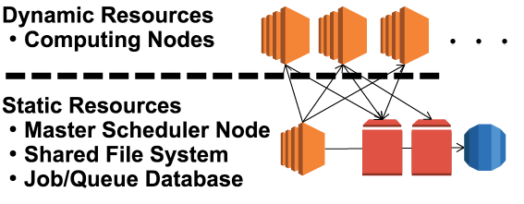
Building Cluster on Cloud
There are some softwares (Galaxy, ElastiCluster, CFN-Cluster, etc…) supporting building cluster on cloud resources. Submitting jobs to scheduler is what most bioinformaticians are used to. But it must have static resources in it.
This is an inefficiency of using cloud services, because “Cloud Service” is already-made cluster!

Slide 4
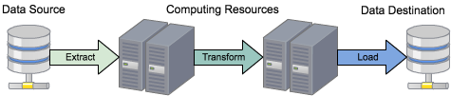
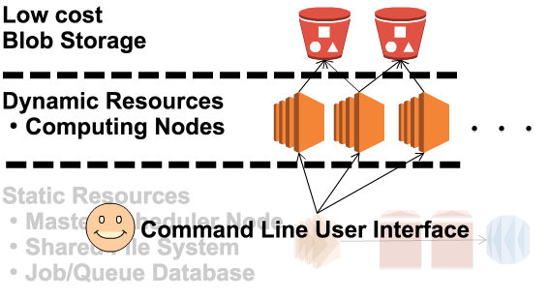
On-demand ETL model
“ETL” (Extract, Transform, Load) is a data processing model for general purpose. Combining with dynamic resource procurement, “on-demand ETL” works well for genome analysis, without any idling resources on cloud.

Slide 5
Huge Common Data matters
With using “on-demand ETL” on Cloud, it often matters that common data, reference genome for example, is so huge that network costs and instance time to download them could be a problem.
e.g.
About 30GB reference for executing STAR to human fastq samples, and that “30GB” is downloaded to each computing node!
cf) “dsub” by Google Genomics

Slide 6
“ExTL”: Extended ETL model
We suggest a novel framework with advantage to plain ETL model, called “ExTL”: Extended ETL model, in which huge common data are downloaded only once to “Shared Data Instance” and the instance is mounted by others.
e.g.
This model can save network traffic
by 30GB * (n – 1)
(n = number of samples)

Slide 7
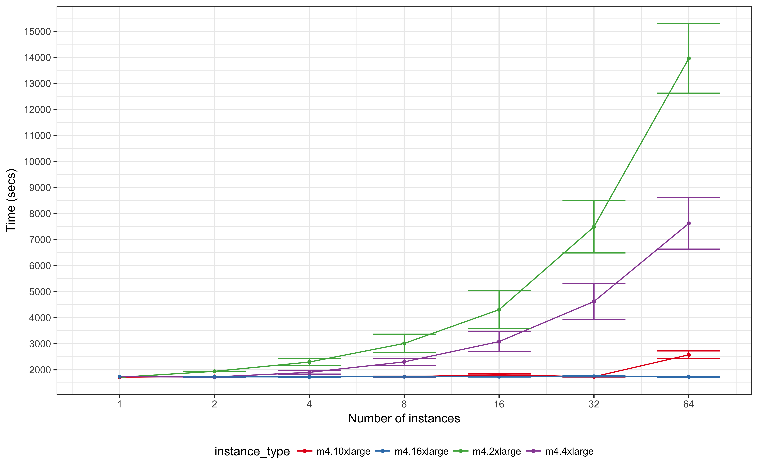
Performance evaluation of ExTL
ExTL bundles duplicated downloading and the “Shared Data Instance (SDI)” is to be mounted by multiple computing nodes (with NFS in our implementation).
This figure describes how long STAR-alignment (RNA-seq) takes time by number of concurrency for fastq samples.
When using poor instance type for SDI, the execution time spikes heavily according to the concurrency.
Workflow: STAR alignment
Reference: GRCh37 (≒ 30GB)
Fastq: G41726.MCF7 (≒ 18+18 GB)
Engine: awsub

Slide 8
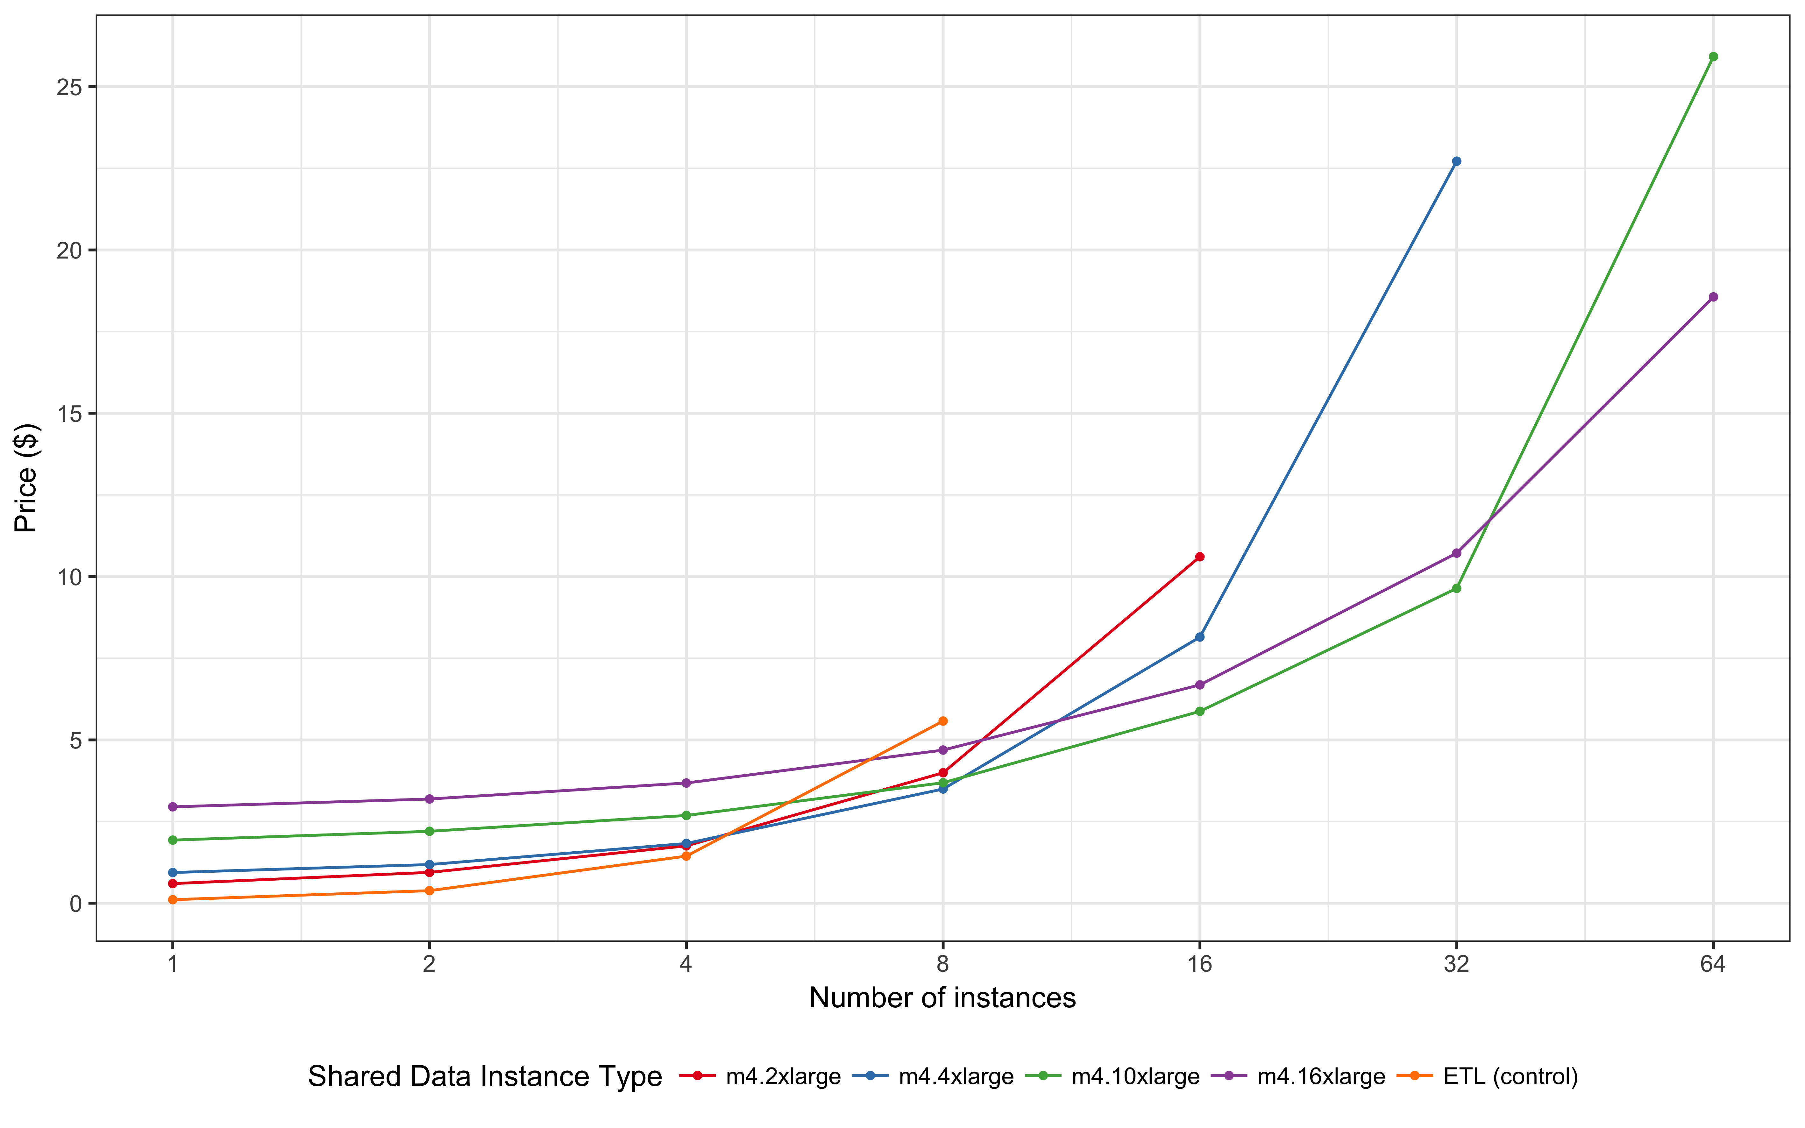
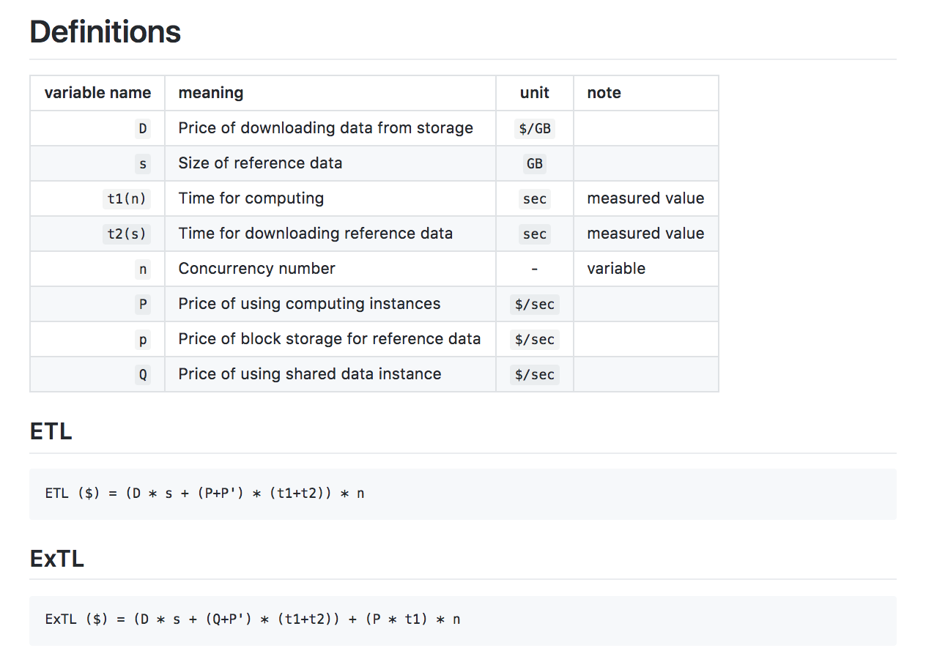
Price evaluation of ExTL (logical)
Based on measured time and instance types actually used, the logical price can be evaluated for this example workflow.
Num of concurrency where plain ETL has cost advantage
ExTL has cost advantage
All the calculation logic are described on
https://github.com/awsub/lab
Check it out and star ;)

Slide 9
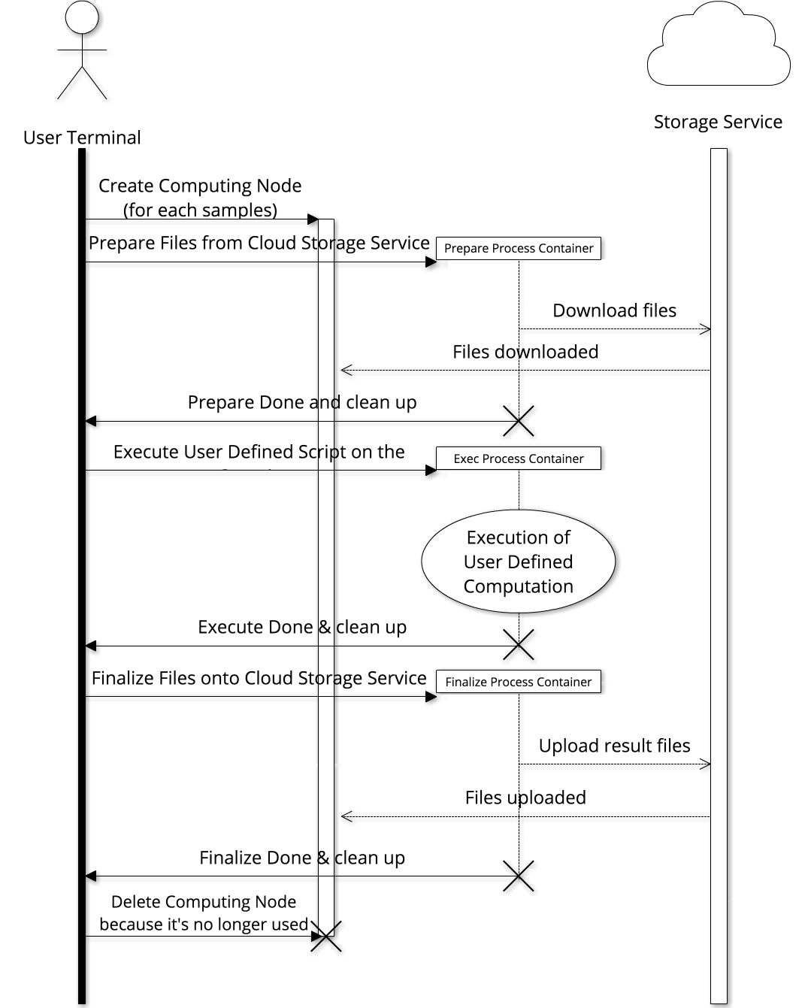
All is Implemented by “awsub”
We implemented a command line tool “awsub”, which is an engine for both ETL and ExTL on multiple* cloud services. (* ETL on AWS and GCP, ExTL on AWS so far)
https://github.com/otiai10/awsub
$ awsub \
--script ./my-workflow.sh \
--image your/docker-image \
--tasks ./input-files-location-list.csv \
--aws-instance-type m4.16xlarge \ # if you want ;)
--verbose

Slide 10
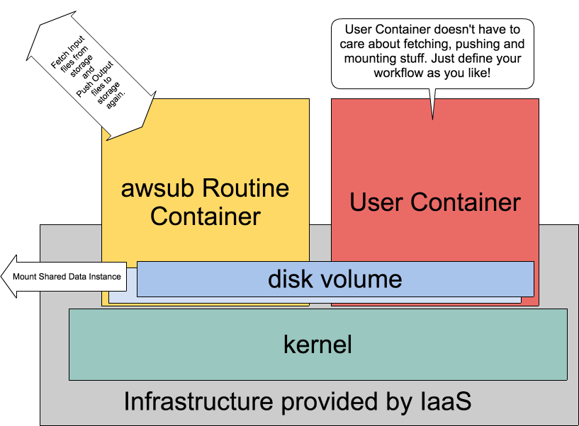
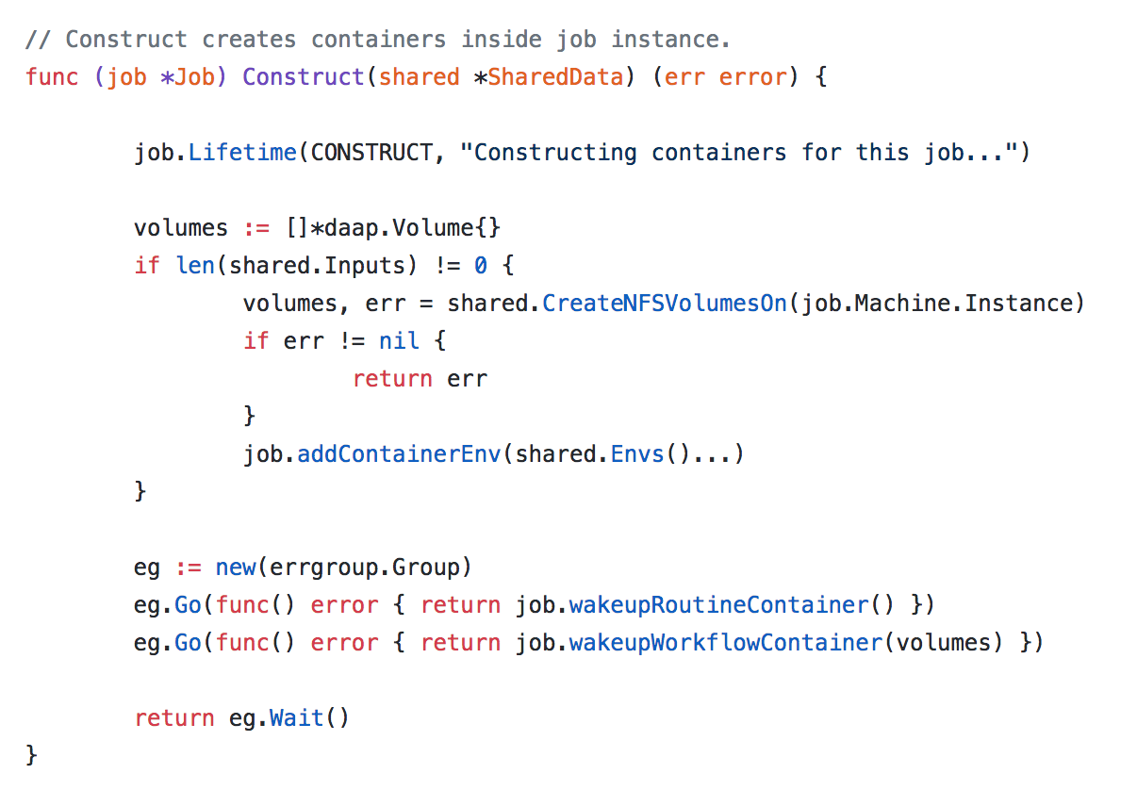
Container Architecture
By using “awsub”, user can execute any script on any runtime by any number of concurrency. This is implemented by container technology powered by Docker.
https://github.com/otiai10/awsub/blob/master/core/job_construct.go

Slide 11
Application Architecture
Thanks for Docker to be implemented by Go, “awsub” is using Docker source code directly as library SDK.
https://github.com/otiai10/daap
Bridge library implemented by Go
More advantage of using Go for “awsub”
Static types
Parallelization by goroutine
Cross compiling binary for multiple platforms

Slide 12
Any questions and feature requests are welcome!!
Feel free to post any questions / issues on https://github.com/otiai10/awsub/issues , or just put questions here!
CWL support is coming soon!

